Slide 1
SPAs with React Router
Overview of React SPAs
Simple routing
Defining links
Link techniques

Slide 2
1. Overview of React SPAs
React and SPAs
Dependencies for React Router

Slide 3
React and SPAs
React has excellent support for implementing SPAs
Define an App component that always remains resident
Define multiple sub-components, which can be swapped in and out of the App component
Each sub-component maps to a logical URL
This is called "routing"
To display a different sub-component in the browser, simply navigate to the URL for that sub-component
3

Slide 4
Dependencies for React Router
To implement routing in React, add the following dependencies in your package.json file
You can make these changes as follows:
{
"dependencies": {
"react-router-dom": "^5.2.0",
"@types/react-router-dom": "^5.1.8",
…
},
…
}
React Router
React Router TypeScript declarations
package.json
npm install --save react-router-dom [for TypeScript or JavaScript]
npm install --save @types/react-router-dom [for TypeScript only]
4

Slide 5
2. Simple Routing
Example application
Creating a router component
Defining a route table
Redirecting paths
Handling 404 errors
Aside: Providing the splash screen

Slide 6
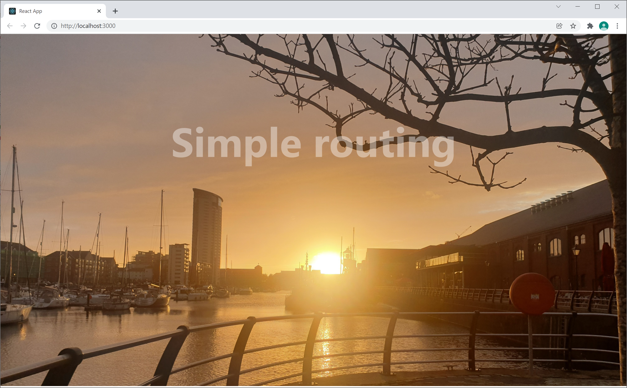
Example Application
Go to the demo-app-1 folder and run
Navigate to the following URLs:
http://localhost:3000/
http://localhost:3000/products
http://localhost:3000/catalog
http://localhost:3000/about
http://localhost:3000/contact
http://localhost:3000/wibble
npm start
6

Slide 7
Creating a Router Component
To enable routing in a React application, you must create a "router" component
Detects URL changes, activates appropriate component
You wrap your <App> root element in a router like so:
import { BrowserRouter } from "react-router-dom";
…
ReactDOM.render(
<BrowserRouter>
<App />
</BrowserRouter>,
document.getElementById('root')
);
index.tsx
7

Slide 8
Defining a Route Table
Define a route table via <Switch> and <Route>
import { Switch, Route } from 'react-router-dom';
…
function App() {
return (
<div>
<Switch>
<Route exact path="/">
<Home />
</Route>
<Route exact path="/products">
<Products />
</Route>
…
</Switch>
</div>
);
}
export default App;
App.tsx
8

Slide 9
Redirecting Paths
You can redirect paths to different paths - like an alias
<Switch>
<Route exact path="/products">
<Products />
</Route>
<Route exact path="/catalog">
<Redirect to="/products" />
</Route>
…
</Switch>
App.tsx
9

Slide 10
Handling 404 Errors (1 of 2)
You can handle 404 errors as follows:
See the PageNotFound component on next slide
<Switch>
…
<Route path="*">
<PageNotFound />
</Route>
</Switch>
App.tsx
10

Slide 11
Handling 404 Errors (2 of 2)
Here's the PageNotFound component
We use the global variable window.location to get the URL requested by the user
import React from "react";
import './PageNotFound.css'
function PageNotFound() {
return (
<div className="pagenotfound">
<h1>OOPS 404</h1>
<p>Invalid URL: {window.location.pathname}</p>
<p>Full URL: {window.location.href}</p>
</div>
)
}
export default PageNotFound;
PageNotFound.tsx
11

Slide 12
Aside: Providing a Splash Screen
Our Home component provides a splash screen
Note how we import the image file
Enables us to refer to the image file in our code
import React from "react";
import './Home.css'
import splash from './swanseamarina.jpg';
function Home() {
return (
<div className="container">
<img src={splash}/>
<div className="centered">Simple routing</div>
</div>
)
}
export default Home;
Home.tsx
12

Slide 13
3. Defining Links
Example application
How to display a link
How to style links
Denoting the current link

Slide 14
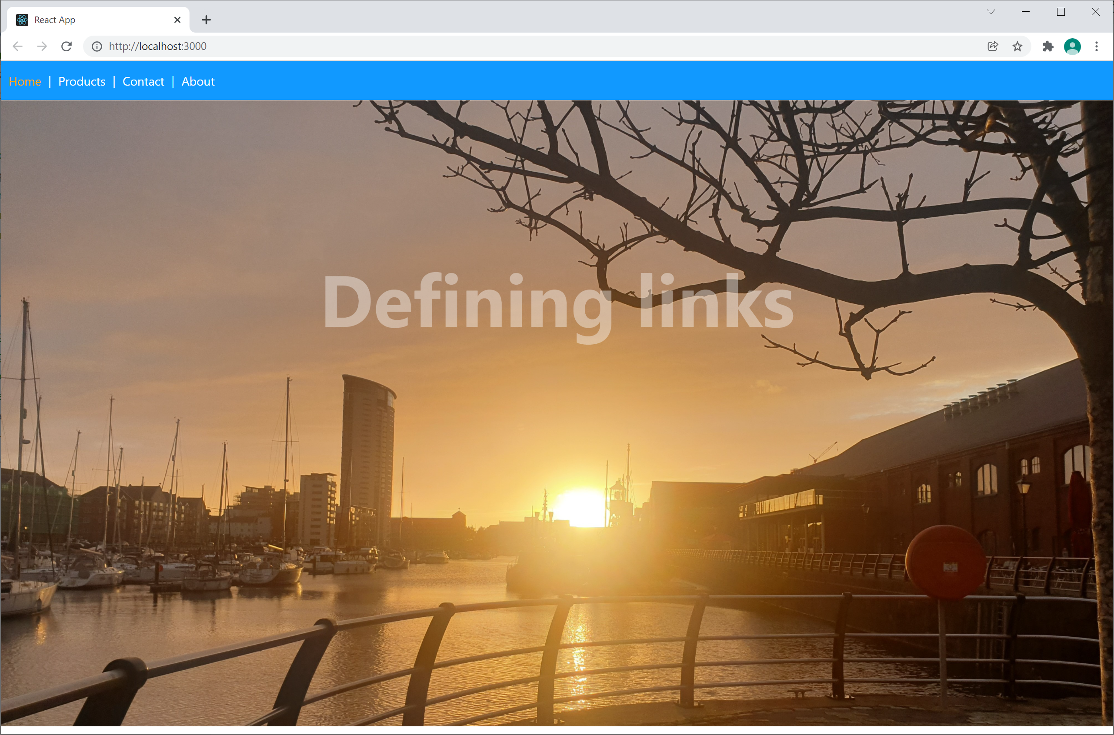
Example Application
Go to the demo-app-2 folder and run
Note we've defined a menu bar of links
Try out each link ☺
npm start
14

Slide 15
How to Display a Link
To define a link, you can use <NavLink>
(Also see App.tsx, where we render the menu)
import React from "react";
import { NavLink } from "react-router-dom";
import "./Menu.css";
function Menu() {
return (
<nav>
<NavLink exact to="/">Home</NavLink>&nbsp;|&nbsp;
<NavLink exact to="/products">Products</NavLink>&nbsp;|&nbsp;
<NavLink exact to="/contact">Contact</NavLink>&nbsp;|&nbsp;
<NavLink exact to="/about">About</NavLink>
</nav>
)
}
export default Menu;
MenuWithLinks.tsx
15

Slide 16
How to Style Links
When you define a <NavLink to="xxx"> …
React renders it as an <a href="xxx">
So you can define CSS styles like this:
nav a {
background-color: #1199ff;
color: white;
text-decoration: none;
padding: 5px;
}
nav a:hover {
color: #1199ff;
background-color: white;
text-decoration: none;
}
Menu.css
16

Slide 17
Denoting the Current Link
<NavLink> applies active CSS class to current link
You can specify visual feedback for the current link
See Menu.css
Note, React also has a simple <Link> component
Doesn't apply the active CSS class
17

Slide 18
5. Link Techniques
Overview
Example application
Defining a data model
Defining parameterized routes
Rendering parameterized links
Obtaining path parameters
Defining nested routes

Slide 19
Overview
In this section we'll see various additional techniques pertaining to links
We'll introduce a "products" data model, and use it to describe the following techniques:
Defining parameterized routes
Rendering parameterized links
Obtaining path parameters from a parameterized route
Defining nested routes
19

Slide 20
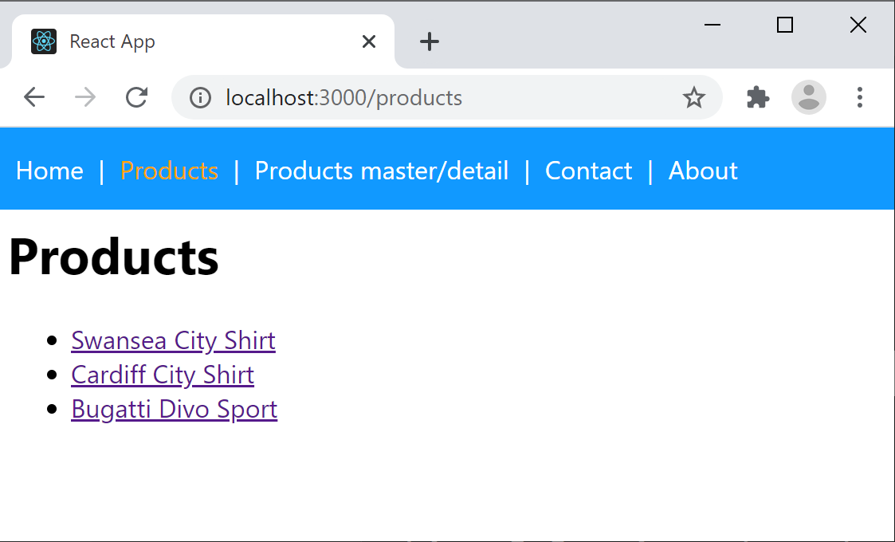
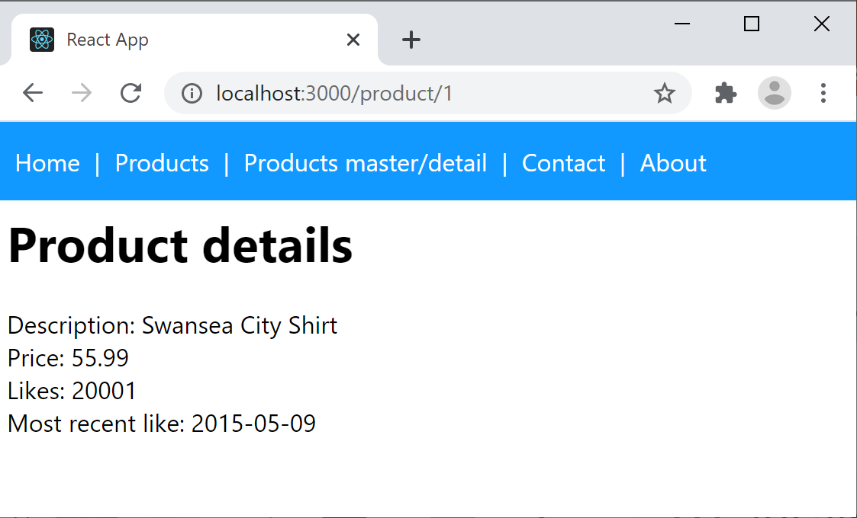
Example Application
Go to the demo-app-3 folder and run
Click the Products link, to display all products
Click a link to see the details for one product
npm start
20

Slide 21
Defining a Data Model
To understand the example application, the first stop is to consider the data model
Take a look at the following TypeScript class files:
ProductItem.ts - Represents a simple product
ProductStore.ts - A simple product store
21

Slide 22
Defining Parameterized Routes
Here's part of the route table
/products - Display all products
/product/:id - Display product with specified id
<Switch>
<Route exact path="/products">
<Products />
</Route>
<Route exact path="/product/:id">
<Product />
</Route>
…
</div>
App.tsx
22

Slide 23
Rendering Parameterized Links
Products.tsx renders parameterized links like so:
function Products() {
let products = ProductStore.getAllProductItems()
return (
<div className="content">
<h1>Products</h1>
<ul>
{products.map((product, i) =>
<li key={i}>
<Link to={`product/${product.id}`}>{product.description}</Link>
</li>
)}
</ul>
</div>
)
}
export default Products;
Products.tsx
23

Slide 24
Obtaining Path Parameters
Product.tsx obtains path parameters like so:
function Product() {
let {id}: any = useParams();
let prod: ProductItem | undefined = ProductStore.getProductItemById(id)
if (!prod) {
…
}
else {
return (
<div className="content">
<h1>Product details</h1>
<div>Description: {productItem.description}</div>
…
</div>
)
}
}
export default Product;
Product.tsx
24

Slide 25
Defining Nested Routes
You can define nested routes
i.e. a page can define its own internal route table
This enables you to create master/detail pages…
Click the Products master detail link on the menu
Renders a "master" page of all products
Click a product, renders the selected product below
See ProductsMasterDetail.tsx
25

Slide 26
Summary
Overview of React SPAs
Simple routing
Router techniques
Defining links
Link techniques

